Slide 1
Bootstarp Workshop
Objectives of the workshop
Understand the advantages of using a component CSS framework.
Know the benefits of reusability in design and development

Slide 2
WHAT IS BOOTSTRAP?
Bootstrap is a widely used CSS framework that can be used to easily and consistently style HTML elements using CSS and (optionally) JavaScript. Bootstrap contains styled components for buttons, cards, dropdowns, input groups, navigation bars, tooltips, and many others, along with utility classes for common CSS properties.
Bootstrap was originally developed at Twitter for their internal web applications but was eventually released to the public as an open source project in 2011.

Slide 3
“INSTALLING” BOOTSTRAP
Bootstrap can be downloaded and used locally, it is commonly accessed via a CDN (content delivery network).
Clicking the “Run” button will load your HTML.
The <link> tag downloads the Bootstrap CSS styles. Note that some components need JavaScript and require an additional script tag, however we won’t we using those components here.

Slide 4
SPACING CLASSES
One of the most helpful Bootstrap utility CSS classes are those made for setting padding and margins. They are named using the format:
{property}{sides}-{size}
Where property can be:
m - to set margin
p - to set padding

Slide 5
SPACING CLASSES
{property}{sides}-{size}
Where sides can be:
t - top
b - bottom
l - left
r - right
x - left and right
y - top and bottom
blank - sets all 4 sides

Slide 6
SPACING CLASSES
{property}{sides}-{size}
Where size can be:
0 - set value to 0
1 - set value to spacer * .25
2 - set value to $spacer * .5
3 - set value to $spacer
4 - set value to $spacer * 1.5
5 - set value to $spacer * 3
auto - set value to auto

Slide 7
BOOTSTRAP COLORS
There are a set of main colors that can be applied to many Bootstrap components:
primary
secondary
success
danger
warning
info
white
light
dark

Slide 8
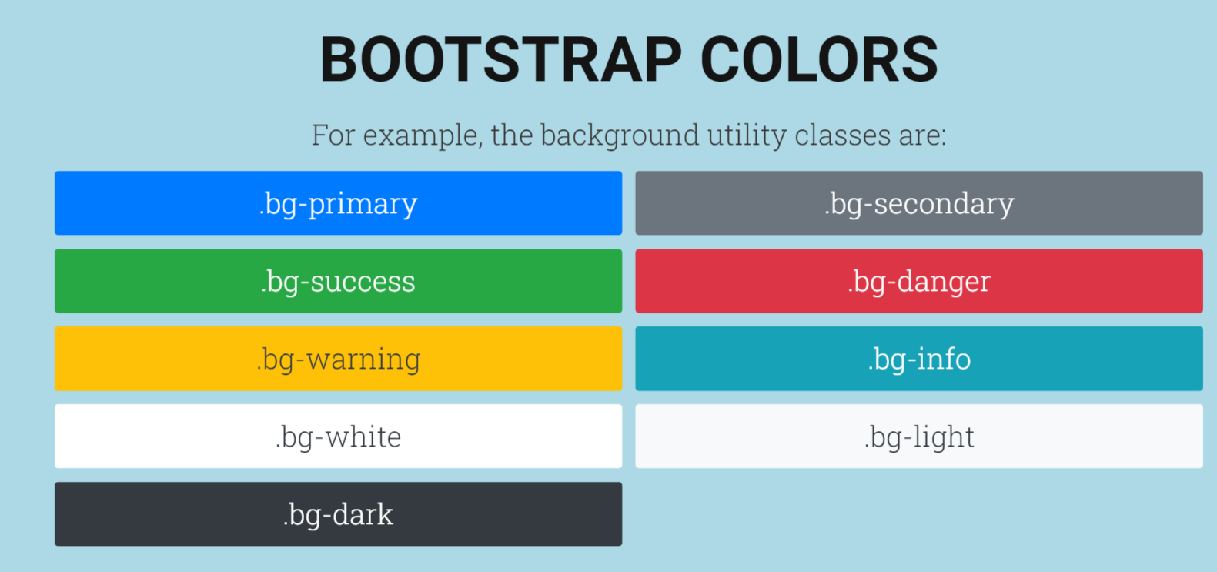

Slide 9
More Components
Buttons
Cards
Tables
Forms

Slide 10
Lets build a single page webapp
Components list
Navbar
Carousal
Cards
form

